Slide 1
Implementation of 4 bit Arithmetic Logic Unit
Course Teacher: Richard Victor Biswas
Lecturer
Department of Electrical and Electronic Engineering
Presented By,
Shilamoni Shaha Neir
20-43640-2

Slide 2

Outline of the Presentation
Objectives (1 slide, several lines, numbered) << What are purposes of this work?
Introduction (2-3 slides) << Background, motivation, and What has been done.
Research/Working Method (1-2 slides) << What are the working principles?
Description of the Work (2-3 slides) << How has the work done? Circuit/Block Diagram.
Results and Discussions (in the form of Tables/Graphs/Plots/Images/Photos/ Figures in 2-6 slides) << What is your present outcome? Discuss each result/outcome.
Conclusions (1-2 slides) << What is your summary?
Future Works (1 slide) << What do you want to do next? Or How someone can carry further research on it?

Slide 3
Objectives of the Work
To Develop and functionally validate a fully operational 4-bit Arithmetic Logic Unit (ALU).
To Analyze and explain the implemented ALU's architectural design and operational principles.
To design and construct dedicated test benches.
Evaluate the implemented ALU and compare it to alternative technologies.
To test the movement of data and control signals through the ALU during different operations.

Slide 4
Introduction
Motivitaion of doing this project:The Arithmetic logic unit (ALU) which considered an essential component in many applications such as Microprocessor, digital signal processing, image processing, etc.
It is a new concept of comparing the technologies to implement 4 Bit ALU.
In previous papers we did not found the trade off with Transmission gate.
In other papers we saw they have used Multiplexer but we did not use any multiplexer in our implementation .

Slide 5
Introduction…
Works has done in previous papers From the literature review:
In the majority of designs, there exists a trade-off between power, delay and area
2. To improve the performance and power dissipation of a chip, a paper present an Arithmetic and Logic Unit (ALU) using the "Power performance tunable Pseudo-Dynamic topology”.
3.Delay Optimization of 4-Bit ALU Designed in FS-GDI Technique
4.Low Power 4-Bit Arithmetic Logic Unit Using
5.Full-Swing GDI Technique

Slide 6
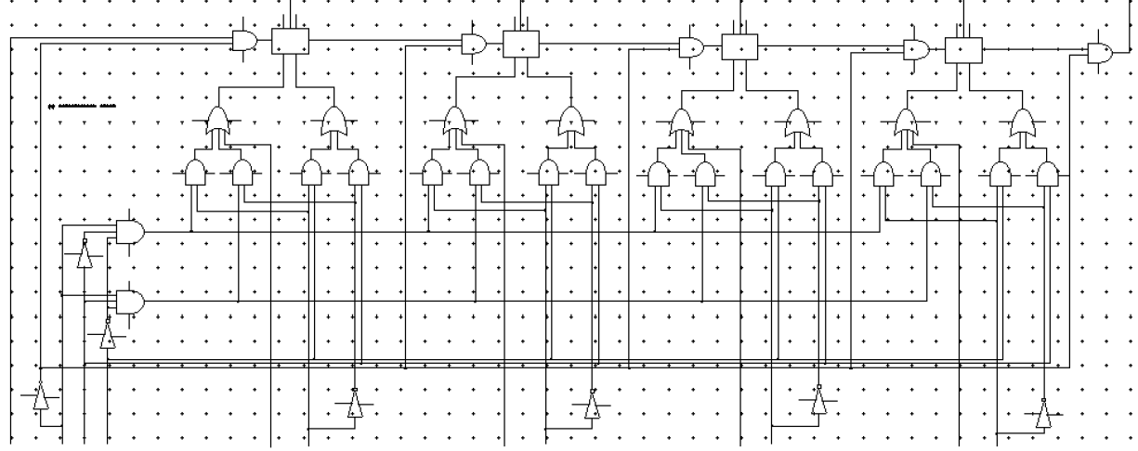
Working Method
4-bit ALU diagram

Slide 7
Working Method…
4-Bit ALU Operation:
The 4-bit ALU takes four pairs of binary inputs: (a1, b1), (a2, b2), (a3, b3), and (a4, b4). It utilizes four full adders and produces four outputs (s1, s2, s3, s4) and a final carry-out (cout).

Slide 8
Working Method…
Internal Processing:
Full Adders: Each pair of inputs (a, b) enters a full adder along with a carry-in (cin) from the previous stage (except cin=0 for the first adder). The adder outputs the corresponding sum (s) and carry-out (cout).
Selection Logic: A control signal, S0, determines whether the carry-out from each full adder participates in the next stage. If S0 is low, the carry-out is ignored, and the operation becomes purely logical. Otherwise, the carry-out acts as a carry-in for the next adder, enabling arithmetic operations.
AND Gates: Two 3-input OR gates and four 2-input OR gates process the signals based on the selection lines S0, S1, and S2. These gates combine the sum outputs (s) and selected carry-out signals (cout) to generate the final ALU outputs (s1, s2, s3, s4).

Slide 9
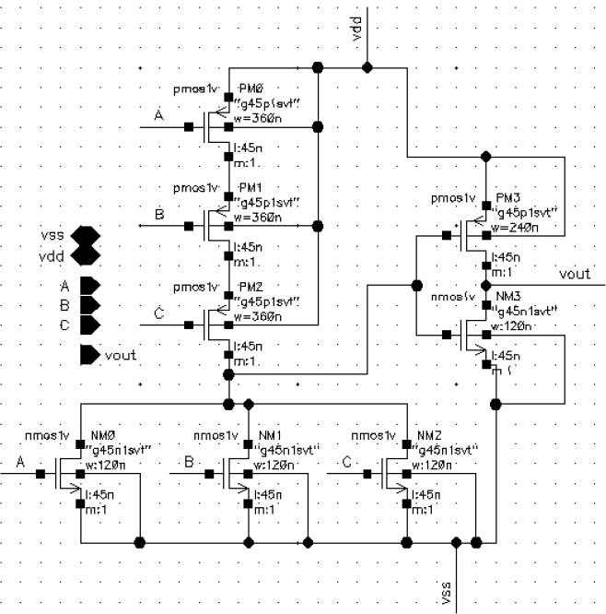
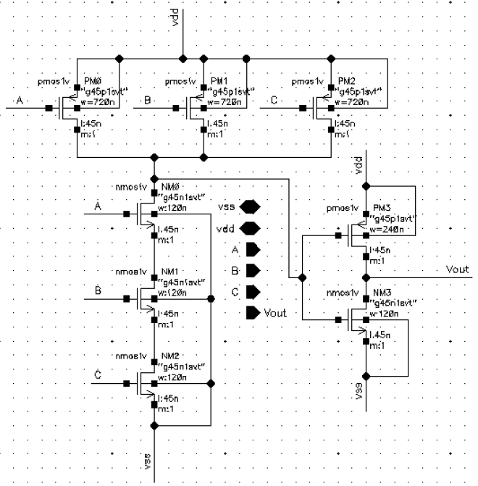
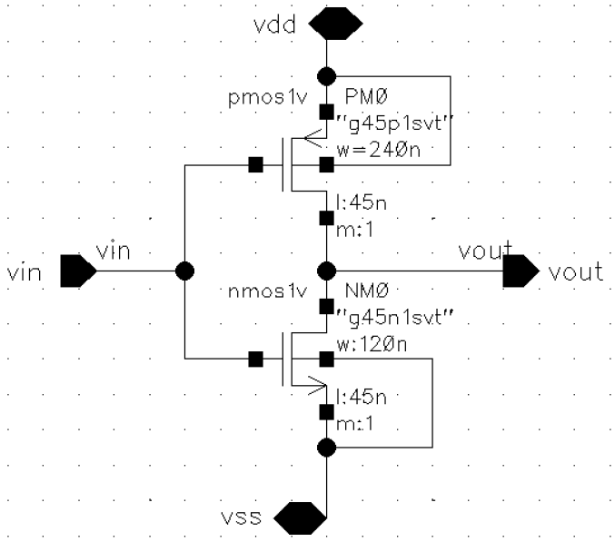
Description of the Work
3 bit or
3 bit and
Inverter

Slide 10
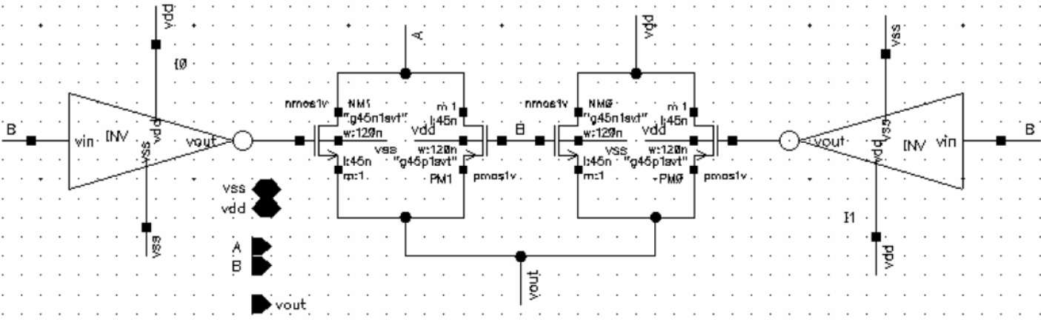
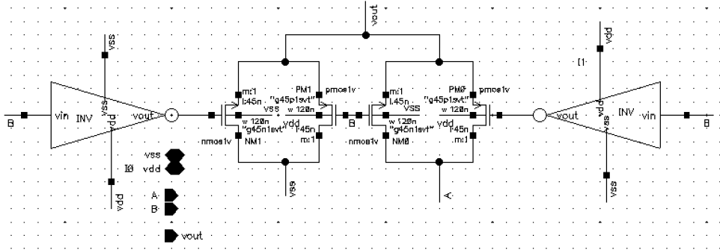
Description of the Work…
Transmission And
Transmission or

Slide 11
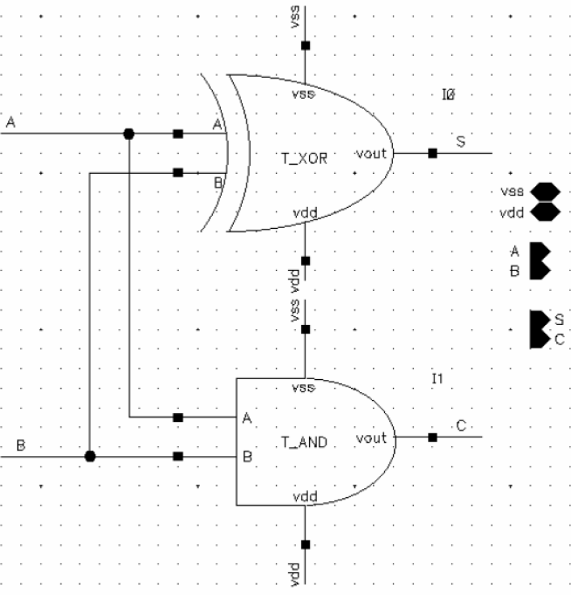
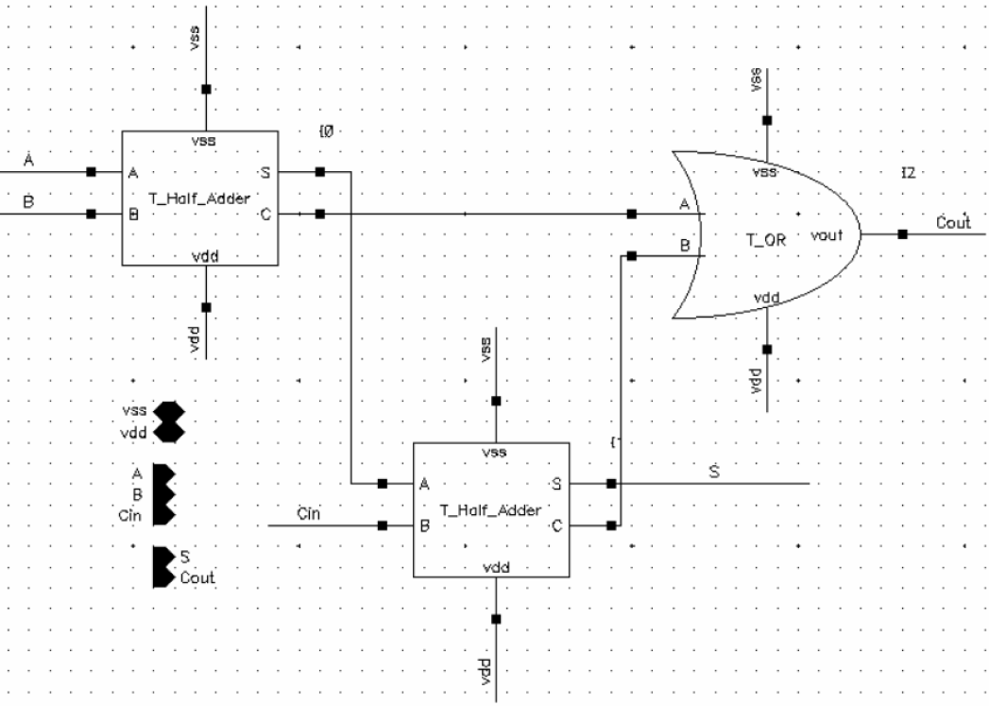
Description of the Work…
Transmission Half adder
Transmission full adder

Slide 12
Results and Discussions
Technology | Cmos
Output | S1 | S2 | S3 | S4 | C_{out}
Skew | 342.979G | 342.962G | 342.962G | 342.962G | 334.46G
Propagation | 67.6548p | 67.6549p | 67.6549p | 67.6549p | 40.011n
Static power | 194.278n | 168.542n | 86.3476n | 86.6481n | 96.6353n
Fall time | 3.73201p | 3.73219p | 3.73219p | 3.73219p | 2.12643p
Rise time | 3.73201p | 3.73219p | 3.73219p | 3.73219p | 2.12643p
Delay Power Product | 1.314*10^-17 | 1.14*10^-17 | 5.841*10^-18 | 5.862*10^-18 | 3.8664*10^-15
Fan IN | 12 | 12 | 12 | 12 | 12
Frequency | 62.9029M | 63.9317M | 50.8164M | 50.8132M | 26.7817M
Technology | Pseudo
Output | S1 | S2 | S3 | S4 | C_{out}
Skew | 247.559G | 247.586G | 247.586G | 248.722G | 235.378G
Propagation | 62.9747p | 62.982p | 62.982p | 63.1955p | 40.0096n
Static power | 389.73u | 389.648u | 390.054u | 390.053u | 389.765u
Fall time | 5.17048p | 5.16991p | 5.16991p | 5.14631p | 3.50496p
Rise time | 5.17048p | 5.16991p | 5.16991u | 5.14631p | 3.50496p
Delay Power Product | 2.45*10^-14 | 2.454*10^-14 | 2.456*10^-14 | 2.464*10^-14 | 1.56*10^-11
Fan IN | 12 | 12 | 12 | 12 | 12
Frequency | 62.902M | 38.3334M | 50.8149M | 50.811M | 26.782M

Slide 13
Technology | Dynamic
Output | S1 | S2 | S3 | S4 | C_{out}
Skew | 448.475G | 445.827G | 445.827G | 445.827G | 396.527G
Propagation | 18.0005p | 18.0005p | 18.0005p | 18.0005p | 4.99722n
Static power | 2.27842m | 213.5u | 2.25571m | 2.17535m | 219.569u
Fall time | 1.76626p | 1.76626p | 1.76626p | 1.76626p | 1.84281p
Rise time | 1.76626p | 1.76626p | 1.76626p | 1.76626p | 1.84281p
Delay Power Product | 4.101*10^-14 | 3.843*10^-15 | 4.060*10^-14 | 3.916*10^-14 | 1.097*10^-12
Fan IN | 13 | 13 | 13 | 13 | 13
Frequency | 163.78M | 152.756M | 203.15M | 159.05M | 131.75M
Technology | Transmission
Output | S1 | S2 | S3 | S4 | C_{out}
Skew | 141.049G | 193.523G | 193.524G | 164.883G | 1.27676G
Propagation | 36.6943p | 36.1983p | 36.2147p | 37.846p | -10.0098n
Static power | 3.51854u | 2.03991u | 1.88836u | 1.83718u | 135.558u
Fall time | 2.26871p | 1.67725p | 1.67725p | 3.29012p | 37.5952p
Rise time | 2.26871p | 1.67725p | 1.67725p | 3.29012p | 37.5952p
Delay Power Product | 129.11*10^-18 | 73.8411*10^-18 | 68.3865*10^-18 | 69.5298*10^-18 | 1.3569*10^-12
Fan IN | 12 | 12 | 12 | 12 | 12
Frequency | 25M | 50.817M | 38.981M | 34.5444M | 27.7789M

Slide 14
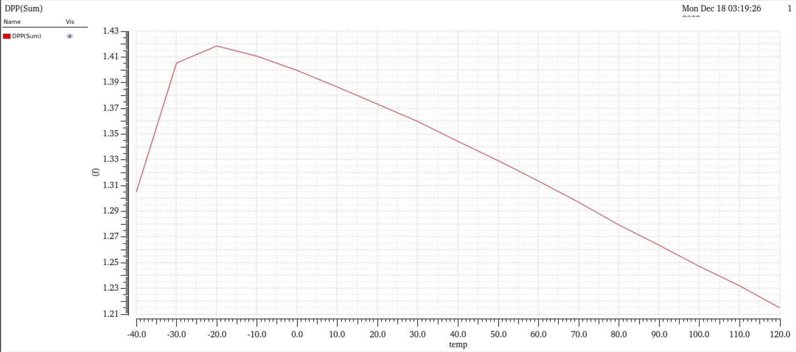
Transmission Gate

Slide 15
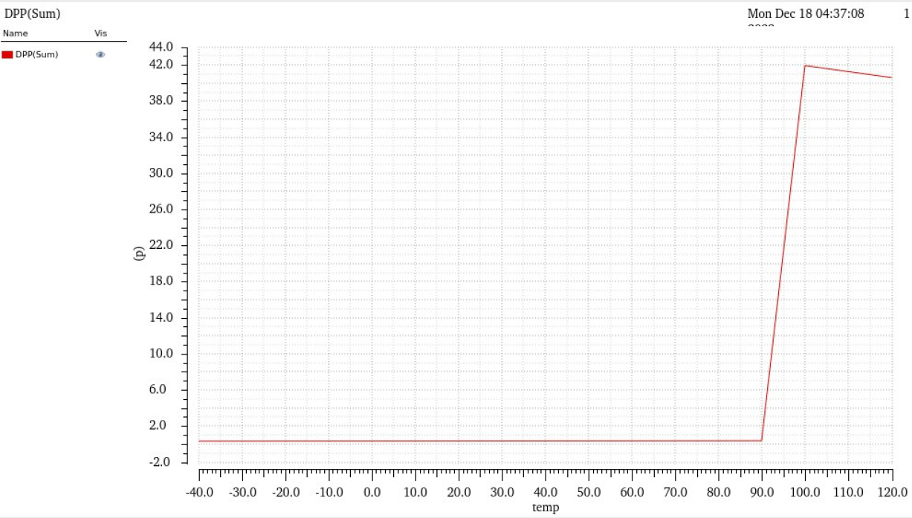
Pseudo Nmos Logic

Slide 16
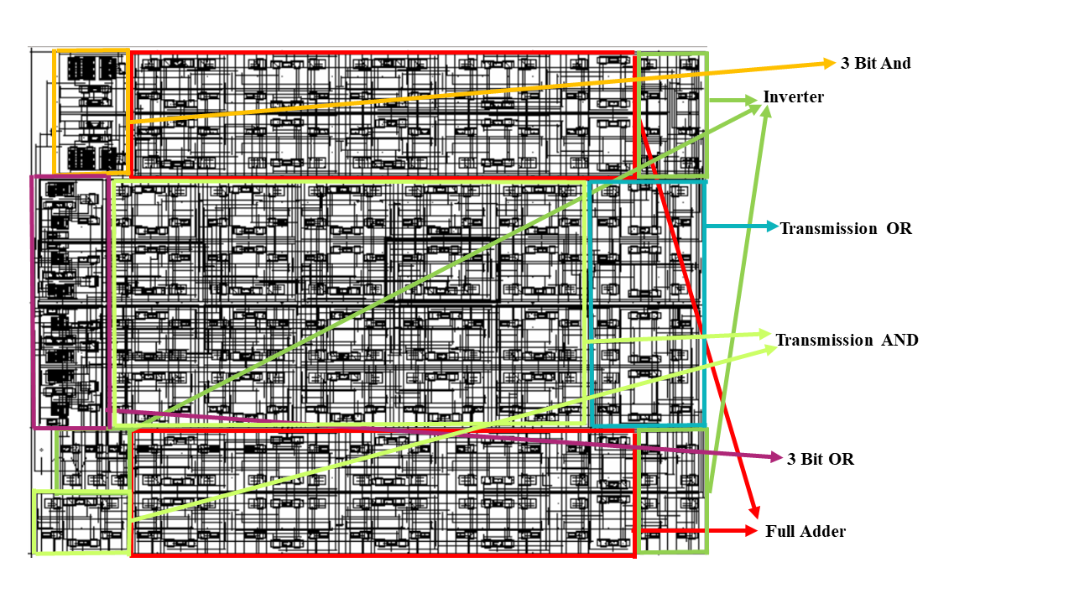
Conclusions
Total Area: 537.265 pm²
Height: 19.995um
Width: 26.87um

Slide 17
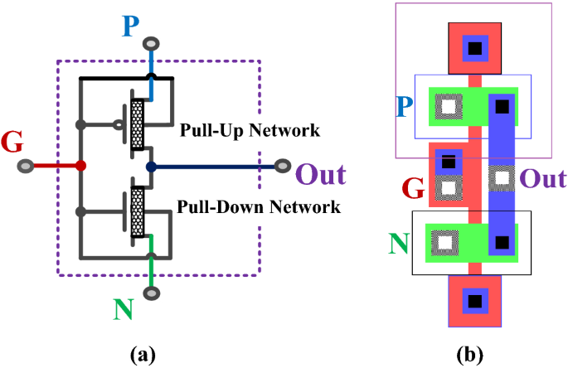
Future Scopes
Reducing Power Consumption
Minimal Delay
Reducing Area

Slide 18


Any Questions?

